Slide 1
Interactive Gender Based Violence Monitoring Dashboard
MUKAKALISA Diane

Slide 2

Project overview and rationale
Problem statement:
GMO’s ability to generate timely, data-driven insights is constrained by fragmented internal reporting and the absence of an integrated, real-time analytics system. This hinders timely response, trend identification, and effective advocacy for victim-centered policies.
Relevance: This project supports GMO’s mandate to strengthen gender accountability by providing a unified digital system for GBV monitoring to enhance evidence-based decision-making and this is aligned with national commitments to prevent and respond to GBV

Slide 3
Objectives:
Provide disaggregated data by age, gender, type of violence, history about the victims and location(Districts) where GBV frequently happens
Track GBV trends over time
Keep track of the victims’ cases and follow-up
Generate descriptive analytics and insights for policy and advocacy.
Team roles:
Names | Roles
MUKAKALISA Diane | Data cleaning, dashboard development, visualization, reporting.
IT officer: | dashboard deployment
GMO Leadership | Validation

Slide 4
Methodology
1. Data Cleaning & Processing:
Standardized dates, phone numbers, location names.
Removed corrupted rows and harmonized variable formats.
  Extracted new variables (year, month, week).
  etc
2. Descriptive Analytics:
Distribution analysis (age, sex, violence types, channels).
District and temporal trends.
3. Visualizations using Streamlit
Data source: GMO received Case reports
Period: 2022-2025

Slide 5
Sample Visualisations
Time series chart for GBV trends.
Top types of violence bar chart.
Age and sex distributions.
Cases by channels used chart
Case progress tracking (Reported → Referred → Returned).

Slide 6
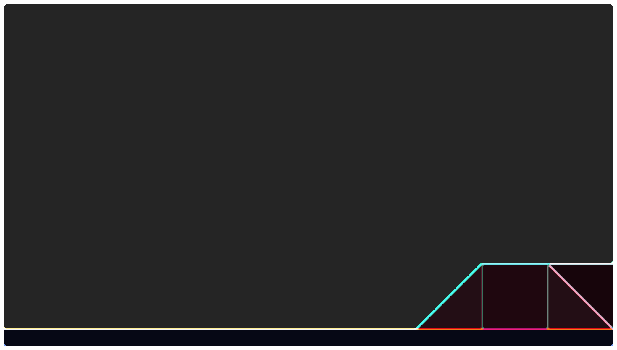
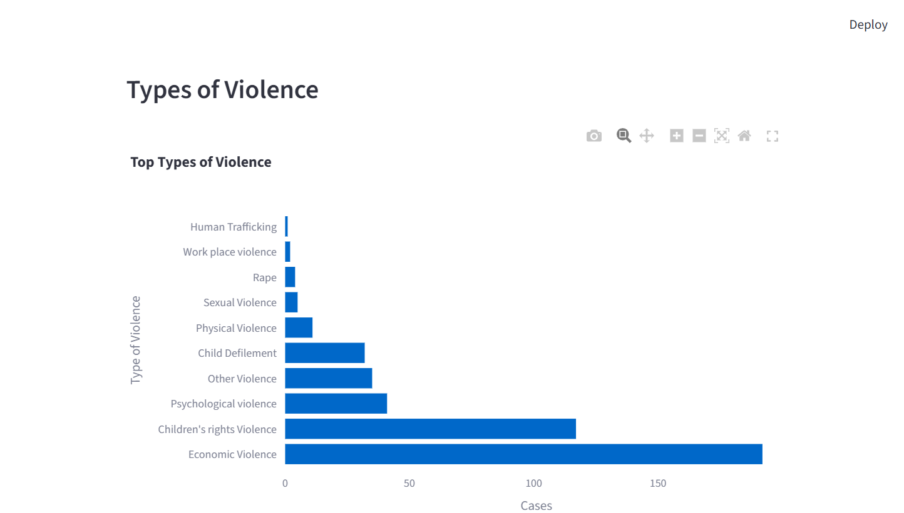
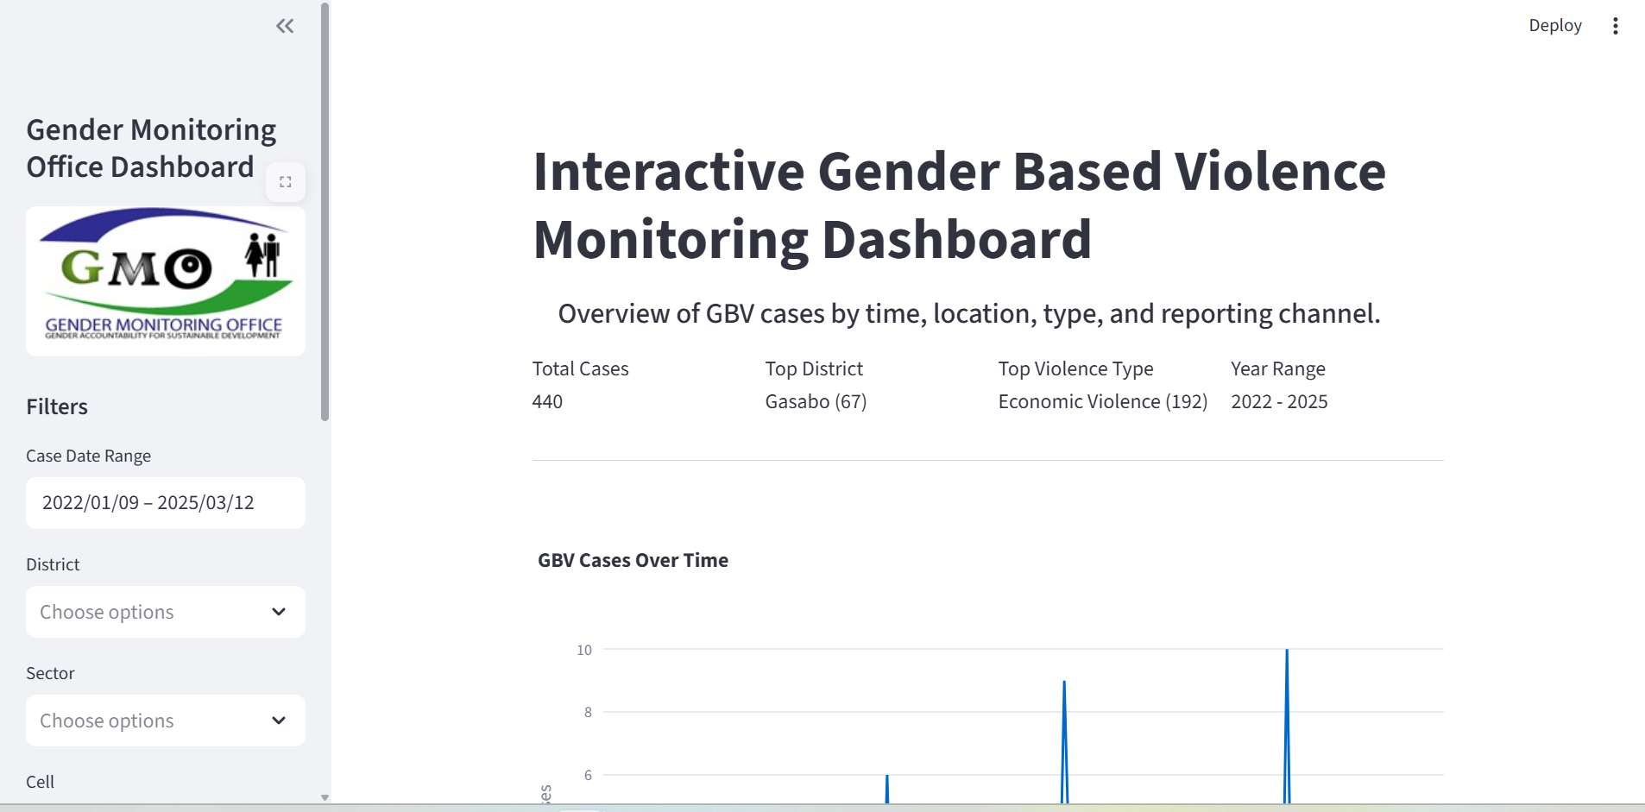
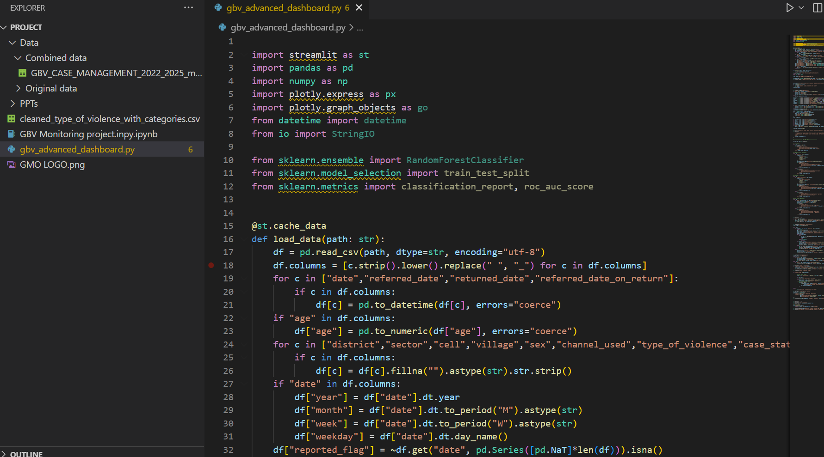
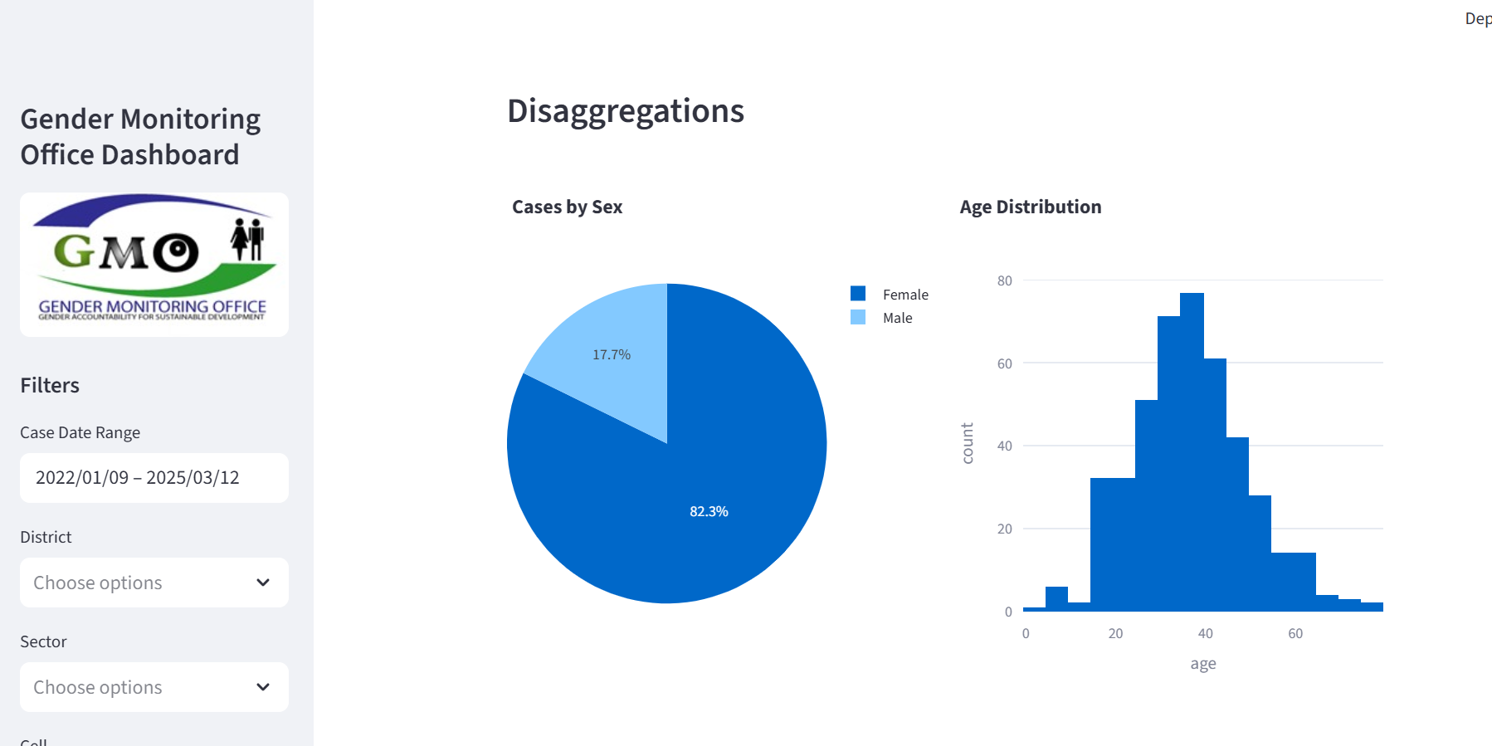
Actual product: Demo screenshots

Slide 7
Key achievements
Functional interactive GBV dashboard developed in Python/Streamlit.
Integrated all major variables: date, district, age, sex, violence type, channel, case summary.
Improved data quality through cleaning and harmonization.
KPI row redesigned to display:
  -Total cases
  -Top district with most cases
  -Top type of violence
  -Year range (2022–2025)
Added GMO branding and logo

Slide 8
Key achievements
Functional interactive GBV dashboard developed in Python/Streamlit.
Integrated all major variables: date, district, age, sex, violence type, channel, case summary.
Improved data quality through cleaning and harmonization.
KPI row redesigned to display:
  -Total cases
  -Top district with most cases
  -Top type of violence
  -Year range (2022–2025)
Added GMO branding and logo

Slide 9

Current status
completed with:
-Data cleaning
-Developed Dashboard
-Visual analytics

Slide 10
Challenges and support needs
Main challenges
Other institutions Data access
Required heavy data cleaning
Support required
Technical support for the dashboard deployment securely (server/website)
Institutional validation and approval for dashboard adoption

Slide 11
Next steps and work plan
Planned activities:
  Finalize dashboard polishing
  Validation with GMO
  Online deployment
  User training and documentation
  As data are too sensitive the dashboard will be used internally and with key specific responsible staff
Milestone | Expected Completion
Final dashboard polishing | 1 week from 17 Nov
Final report submission | End of project 12th Dec

Slide 12
Conclusions and recommendations
Key takeaways
Data processing techiniques
Recommendations
Visual analytics help highlight hotspots and high-risk categories.
Internal institutional adoption
Ensure regular maintenance and updates to keep data relevant
A centralized dashboard significantly improves visibility of GBV trends.
Expand dashboard with additional datasets (e.g., justice outcomes

Slide 13
Thank you!

